Slide 1
Window Programming 1-2
Basic component: Label, TextBox, Button

Slide 2
Label (標籤)
Present text information to users
  Text
    label1.Text="Hello!";
  AutoSize
    label1.AutoSize=True;

Slide 3
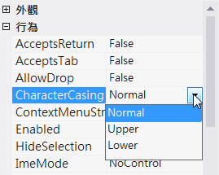
TextBox
For users to click
  Text
  Multiline
  PasswordChar
  Enabled
  ReadOnly
  CharacterCasing
成員名稱 | 說明
Normal | 字元的大小寫會保持不變。
Upper | 將所有字元都轉換成大寫。
Lower | 將所有字元都轉換成小寫。

Slide 4
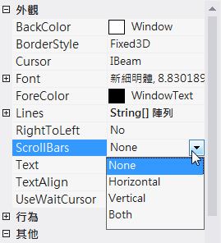
TextBox
For users to click
  WordWrap
  ScrollBars
  Lines
    textBox1.Lines=new string[]{"Hello!"};
Event
  TextChanged
成員名稱 | 說明
None | 不顯示捲軸。
Horizontal | 只顯示水平捲軸。
Vertical | 只顯示垂直捲軸。
Both | 同時顯示水平和垂直捲軸。

Slide 5
Button (按鈕)
For users to click
Event
  Click

Slide 6
Use program code to set up attribute

Slide 7
Event function of object
Event function name=object name + Event
  button1_Click
  textBox1_TextChanged

Slide 8
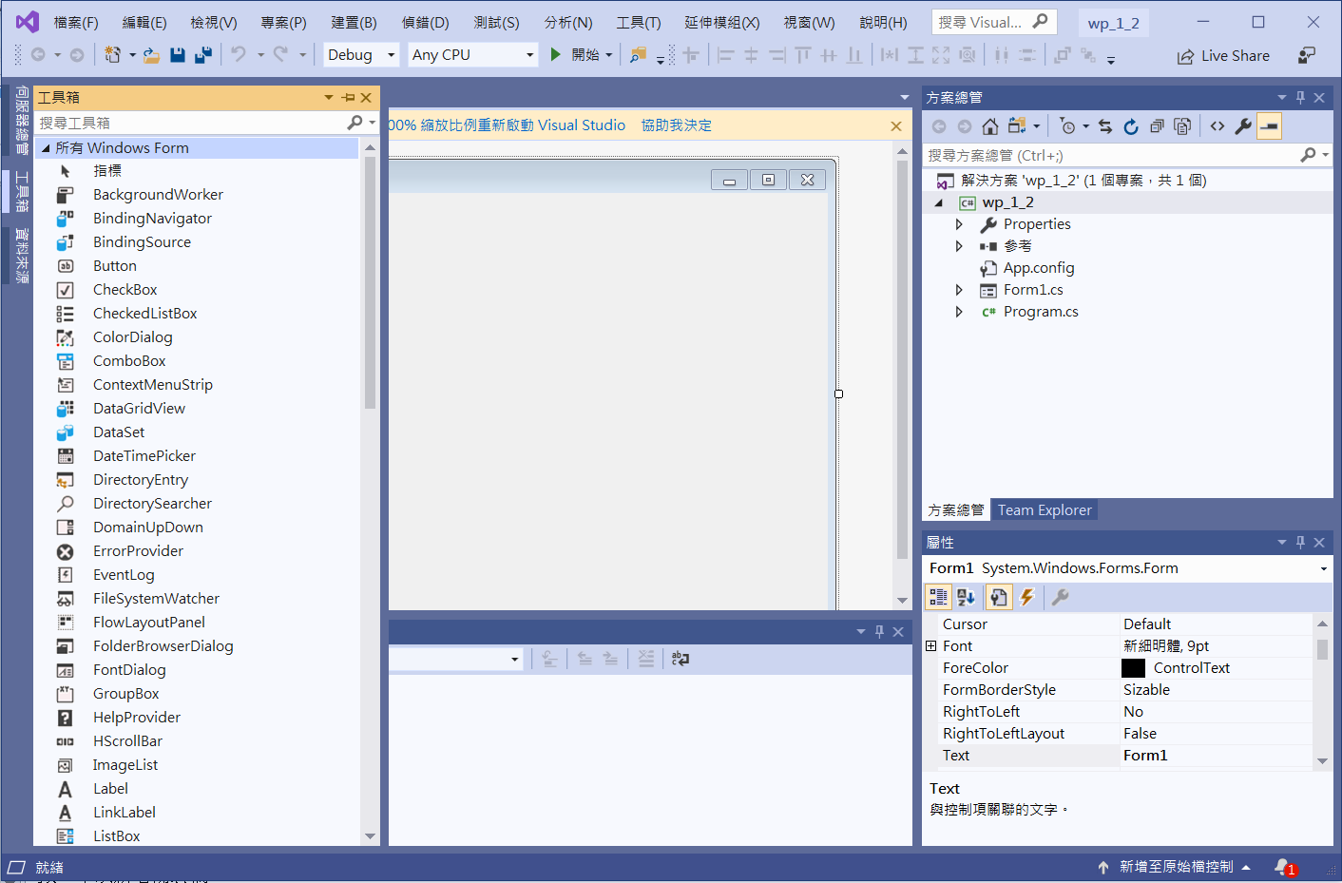
Component
2. 所有Windows Form
1. 工具箱

Slide 9
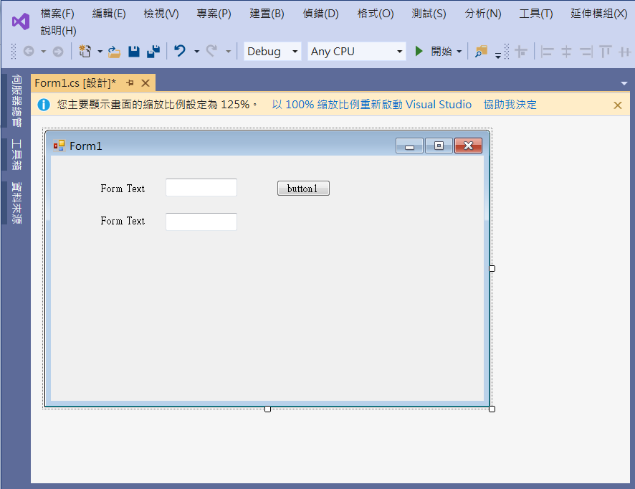
Component
textBox1
button1
label1
label2
textBox2

Slide 10
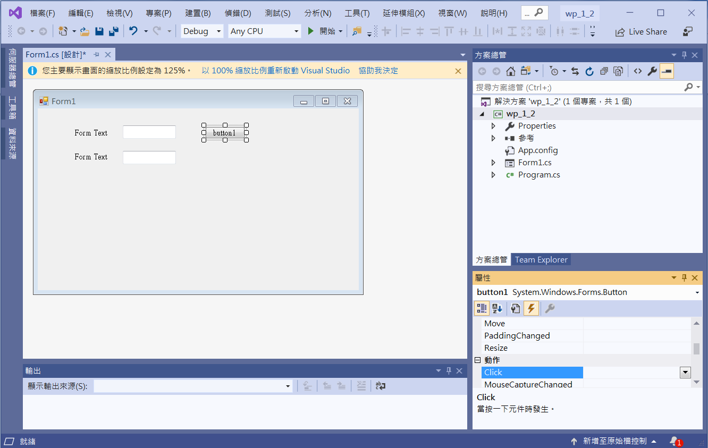
Component
1. Choose button1
2. Click at Event
3. Double Click at Click event

Slide 11
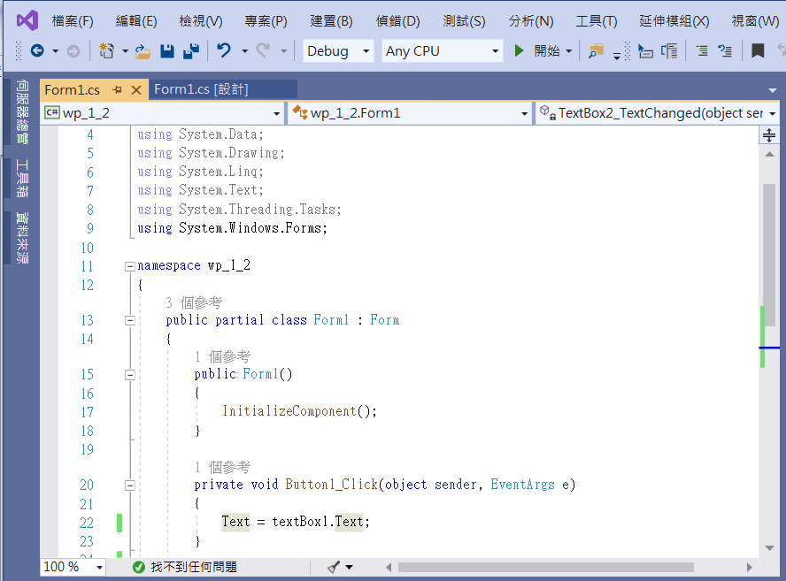
Component
Add code

Slide 12
Component
private void Button1_Click(object sender, EventArgs e)
{
Text = textBox1.Text;
}

Slide 13
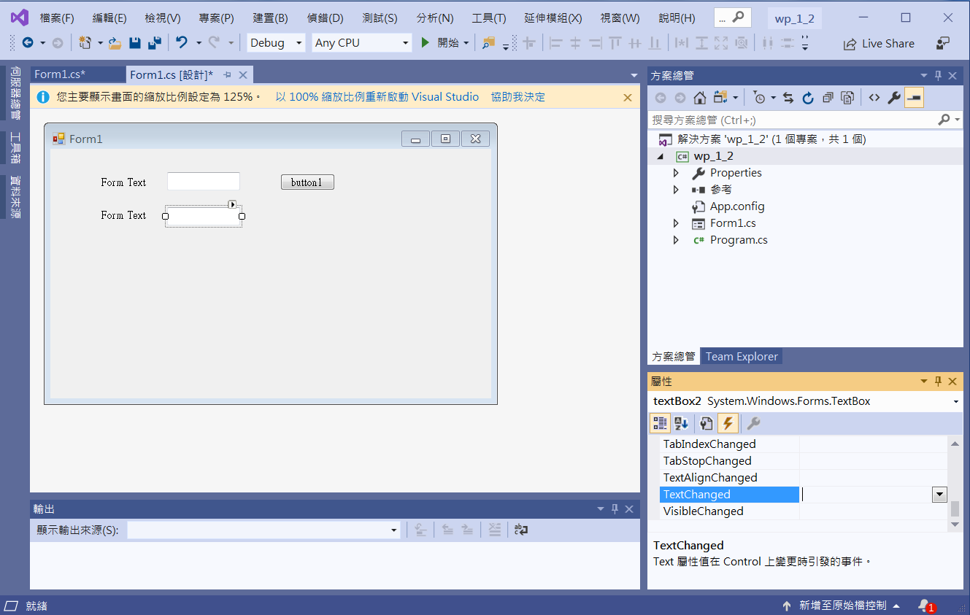
Component
1. textBox2
2. Click at event
3. Double Click at TextChanged

Slide 14
Component
private void TextBox2_TextChanged(object sender, EventArgs e)
{
Text = textBox2.Text;
}

Slide 15
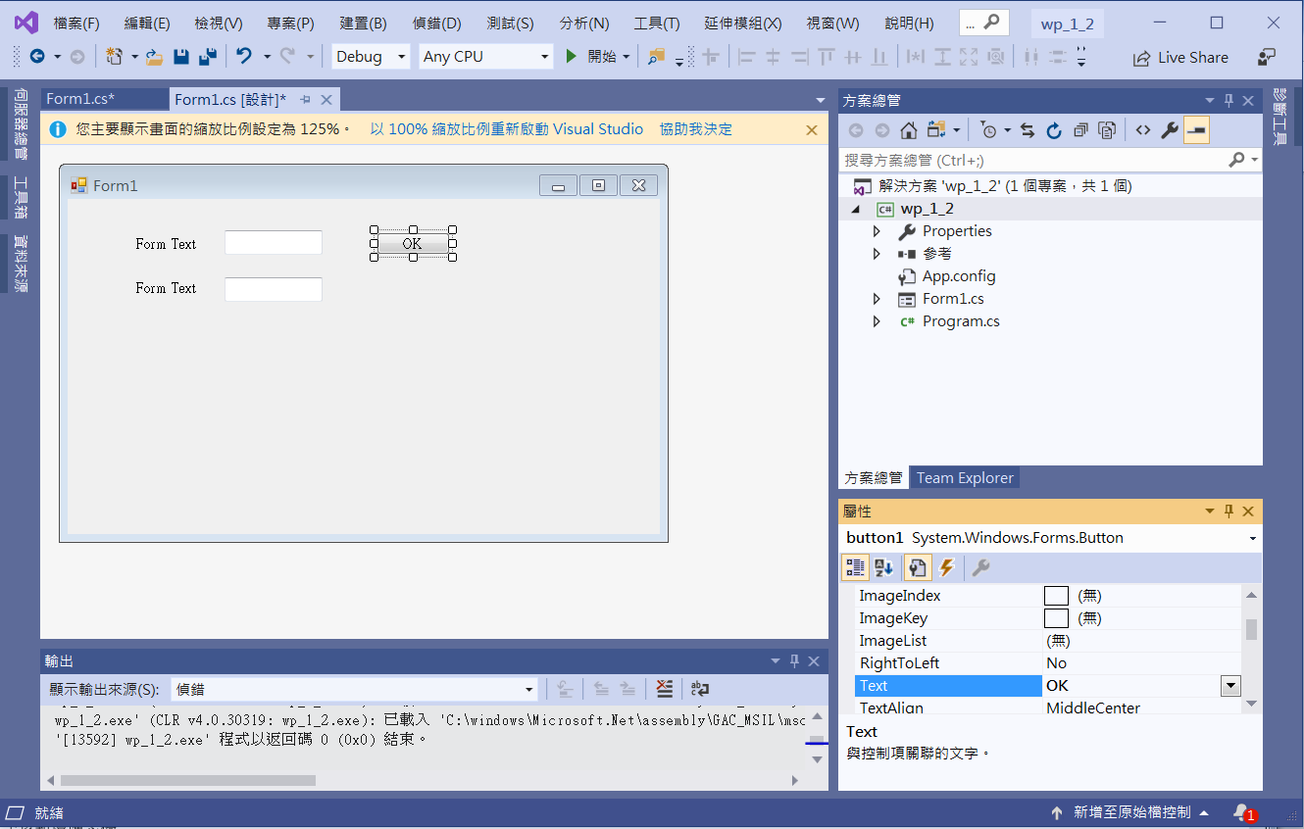
Component
1. button1
2. Click at attribute
3. Edit Text to change the text on button1

Slide 16
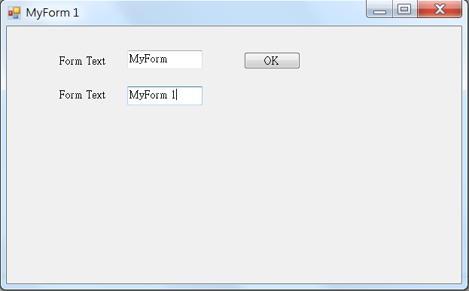
Exercise#1-2

